Slide 1
Addiction as Disease
Crime and Treatment
Man as Automaton
Neil A Kurtzman, MD
Internal Medicine Grand Rounds
May 29, 2002

Slide 2
Health is a state of complete physical, mental and social well-being and not merely the absence of disease or infirmity.
Constitution of the World Health Organization

Slide 3
Disease: Any deviation from or interruption of the normal structure or function of a part, organ, or system of the body as manifested by characteristic symptoms and signs; the etiology, pathology, and prognosis may be known or unknown.
Dorland’s Medical Dictionary, 29th edition

Slide 4
Is it any wonder we’re confused with definitions like these?
Notice that “Disease” says nothing about the “deviation” being harmful
Homosexuality is a disease according to the above definition
So is doing great mathematics to the exclusion of everything else, eg Ramanujan

Slide 5
Disease is a state that places individuals at increased risk of adverse consequences.
Temple et al, Science 293:807, 2001
This definition includes not wearing your seat belt, joining the SEALs, and walking in the wrong part of town.

Slide 6
A disease has an exclusive pathogenesis; DM is always due to an absolute or relative deficiency of insulin
It has the potential for harm
It is never voluntary, though voluntary acts may cause disease. The voluntary act itself is not the disease
All acts are voluntary until proven otherwise

Slide 7
Humans are held to be responsible for their acts
Mental illness absolves the patient of responsibility for his acts
Mental disease differs from all other illnesses because of volition

Slide 8
The influence of scientific patterns of thought on our general outlook has become extremely pervasive; and the overwhelming majority is today uncritically in thrall to more or less crude forms of scientism.
Roger Hausheer, Introduction to Isaiah Berlin, The Proper Study of Mankind, 1997

Slide 9
Suppose I am an alcoholic, a slave to the bottle. Would I not wish to renounce part of my liberty that enslaves me to the bottle. (W)hat are we to do with the majority of mankind who are unable to master their sinful passions?
-more-

Slide 10
Here, says Berlin, the real horror of a purely rational view of life unfolds. For if it can be shown that there is only one correct view of life, people who fail to follow it must be forced to do so.
Noel Annan, Foreword to Isaiah Berlin, The Proper Study of Mankind, 1997

Slide 11
Negative liberty: The freedom to act without outside interference. “It (is) easy for me to conceive of myself as coercing others for their own sake…. Once I take this view I am in a position to ignore the actual wishes of men or societies, to bully, oppress, torture them in the name, and on behalf of their ‘real’ selves.”
Berlin, Two Concepts of Liberty, 1958

Slide 12
Liberty is the absence of coercion. “Coercion, however, cannot altogether be avoided because the only way to prevent it is by the threat of coercion. Free society has met this problem by conferring the monopoly of coercion on the state.”
Hayek, The Constitution of Liberty, 1960, p 21

Slide 13
Liberty and responsibility are inseparable…. It (responsibility) often evokes the outright hostility of men who have been taught that it is nothing but circumstances over which they have no control that has determined their position in life or even their actions.
Hayek, p 72

Slide 14
It is doubtful that democracy could survive in a society organized on the principle of therapy rather than judgement, error rather than sin. If men are free and equal, they must be judged rather than hospitalized.
FD Wormuth The Origins of Modern Constitutionalism, 1949

Slide 15
Faith-Based Biology

Slide 16
At present there is no reliable evidence from large randomised trials to support screening mammography programmes.
Richard Horton, The Lancet 358:1284, 2001
There is no reliable evidence that screening for breast cancer reduces mortality.
Gotzche and Olsen, Lancet 355:129, 2000

Slide 17
In medicine we never abandon a futile treatment until an effective one appears. Thus, I’m convinced we will persist in our costly and ineffective diagnostic and therapeutic campaign against breast cancer until someone comes up with something that really works.
-more-

Slide 18
Then everyone will admit that what we are now doing never worked and will wonder how we could have persisted for so long when it so obviously was a failure. In the meanwhile, the expenditure of emotional energy will exact a greater price than dollars spent for no discernible end.
Kurtzman, Am J Kidney Dis 35:327, 2000

Slide 19
Opium alone stands the test of experience as a remedy capable of limiting the progress of the disease (Diabetes Mellitus).
Osler, The Principles and Practice of Medicine, 1892, p 304

Slide 20
Medicine is not a science
The therapeutic imperative overwhelms everything, including Primum non nocere
WP

Slide 21
Our attitudes towards addiction are exactly what you would expect from simultaneously loosing thousands of lawyers and psychiatrists on the same problem.

Slide 22
Alcoholism as a disease is no more than 200 years old, though it has been used for thousands of years
Levine, J Stud Alcohol 39:143, 1978
Alcoholism as a disease which only affects a small group of biologically predestined individuals is less than 70 years old
Peele, J Psychoactive Drugs 20:375, 1988

Slide 23
Alcohol and opiate use were much more common in the 19th century than now
Both were criminalized in the 20th century and then medicalized
“Addiction is now defined as an illness because doctors have categorized it thus”
Berridge & Edwards, Opium and the People, Yale Univ Press, 1987, p 130

Slide 24
Homosexuality is no longer defined as an illness because doctors no longer categorize it as such.

Slide 25
DSM IV devotes 98 pages to Substance
Abuse
Mental Health: A Report of the Surgeon General, 1999 barely mentions it

Slide 26
Although addictive disorders are included as mental disorders in the DSM classification system, they are distinguished from all other mental disorders in the Surgeon General’s Report.

Slide 27
Drinking problems are virtually unknown in most of the world’s cultures. Solitary, addictive drinking behavior does not occur to any significant extent in small-scale traditional societies.
Heath, Encyclopedic Handbook of Alcoholism, 1982, p 426
Beverage alcohol is usually not a problem in a society unless it is defined as such
Marshall, Beliefs, Behaviors, and Alcoholic Beverages, 1979, p 451

Slide 28
Bad driving could just as readily be considered a disease by those who think alcoholism a disease
It kills thousands of people
It is, however, voluntary and has many causes
It’s amenable to intervention
You can teach some people to be better drivers
One could look for genetic markers for bad driving

Slide 29
Cocaine and opium were commonly used in 19th century patent medicines
Godfrey’s Cordial, which contained opium, was given to quiet Victorian babies

Slide 30
Of all men addicted to heroin in Viet Nam, only 12 % relapsed to addiction after their return
Of those addicted in the first year back, half were treated and half were not
47% of those treated had a second relapse
17% of those not treated had a second relapse
Robbins, et al, Yearbook of Substance Abuse, 2:213, 1980

Slide 31
Half of those addicted to heroin in Viet Nam used it after returning to the US
Only one-eighth became readdicted
Heroin use led to addiction no more often than did amphetamine or marijuana use
Robbins, et al

Slide 32
Animals in spacious cages shared with other rats vastly prefer water to narcotic solution even after having drunk the solution exclusively for weeks
Animals that consume drugs and alcohol excessively when under extremely uncomfortable conditions cease when normal lab conditions are restored
Falk, Pharacol Biochem Behav 19:385, 1983

Slide 33
Most animals cannot be made into addicts. In response to drugs regularly reported to addict humans animals generally avoid such drugs when given a choice.
Dole, Sci Am:138, June 1983

Slide 34
Smoking is highly addictive
Yet 36 million people have stopped without any treatment though tobacco is more addictive than cocaine (Fiore et al, JAMA 263: 2760, 1990)
I can get almost anybody to stop instantly with four words

Slide 35
You have lung cancer

Slide 36
Addiction as a disease has a strong economic basis. Those who provide the care depend on this concept for their livelihood. This, at least in part, explains the persistence of expensive inpatient regimens for alcohol though every study has shown outpatient treatment to be at least as effective
Miller and Hester, Am Psychol 41:794, 1986

Slide 37
Miller et al at the University of New Mexico evaluated 43 kinds of alcohol abuse treatment from 211 controlled trials. The treatment with by far the best score was “brief intervention”.
Peele, The Sciences March/April 1998

Slide 38
The concept of addiction as disease has been used to explain almost every human failing and thus to absolve miscreants of responsibility for their bad acts. When Wade Boggs was caught in an illicit sexual relationship, he confessed to sex addiction. His former mistress said, “I guess what I thought was love was just a disease.”

Slide 39
Cocaine produces no gross physiological withdrawal symptoms (Gawin, Science, 251:1580, 1991; DSM IV, 1994 p 225)
In 1990 the NIDA found that 11.5% of Americans had used cocaine, but only 0.9% in the last month; only 0.09% used it weekly (DHHS Publication # ADM 91-1732)
The vast majority of cocaine users do not become chronic users

Slide 40
Cocaine-driven humans will relegate all other drives and pleasures to a minor role in their lives…. If we were to design deliberately a chemical that would lock people into perpetual usage it would (be) cocaine (Cohen, US Govt Printing Off, 1984)
Repeated doses of addictive drugs – opiates, cocaine, and amphetamine – cause drug dependence and afterward, withdrawal (Hyman, Science 273:611, 1996)

Slide 41
After 10 years, 60% (of cocaine users) had become completely abstinent, and 40% remained occasional users. Most drug users ultimately stop. Drugs no longer fit their lifestyle. They get jobs, they have to get up early, they stop going to the disco, they have kids.
Peter Cohen, Centre for Drug Research,
University of Amsterdam

Slide 42
Americans born before 1905 had a 1% rate of depression by age 75
Americans born 50 years later had a 6% rate of depression by age 24
In the 1960s the average age of onset for manic-depression was 32
In 1995 it was 19
Only social factors can explain the above
Peele and DeGrandpre, Psychol Today July/Aug 1995, p 62

Slide 43
Antidepressants work
They have cellular and biochemical effects
But “the gulf between the description of drug action (at the cellular and biochemical level) and the description at the functional and behavioral level remains very wide. Attempts to bridge it seem like throwing candy floss into the Grand Canyon.”
Rang et al quoted in Glynn The Anatomy of Thought, Oxford Univ Press, 1999, p 349

Slide 44
The Brain/Behavior Syllogism
The brain controls behavior
The brain is an organ
Therefore, behavior can be understood by examining the biological mechanisms that are common to all organs

Slide 45
Compulsive drug-seeking behavior is often attributed to the seductive reinforcing of certain insidious drug molecules. Rather behavioral variables are as important as pharmacological ones in the development of compulsive drug-seeking behavior.
Charles Schuster, Director, National Institute on Drug Abuse

Slide 46
The Molecular Psychiatrist
Sir, a psychiatrist doing molecular biology is like a dog walking on his hind legs. It is not done well, but you are surprised to find it done at all.
Apologies to Sam Johnson and James Boswell

Slide 47
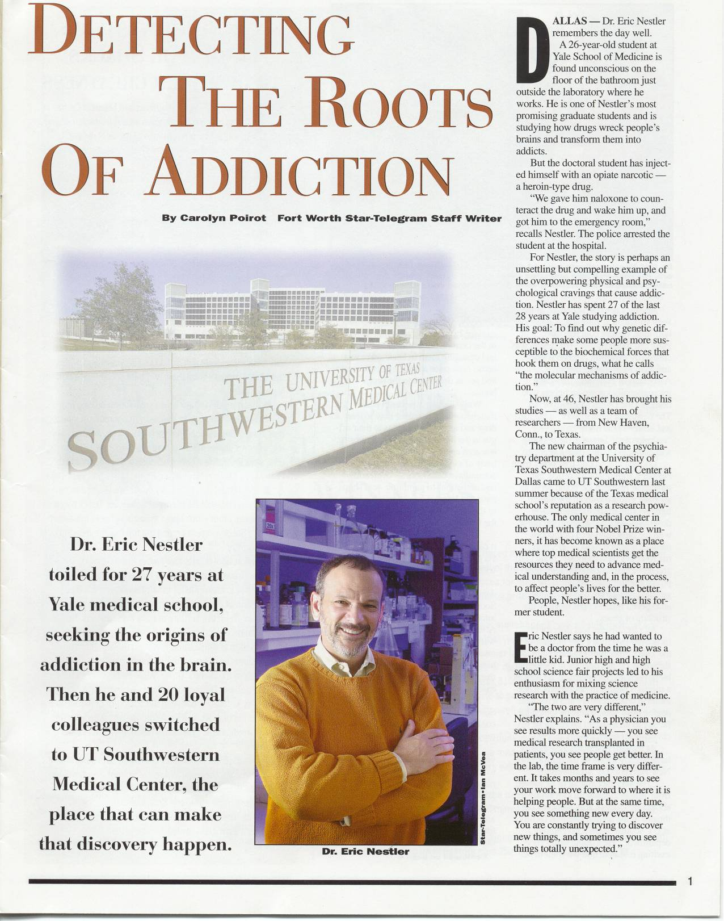

Slide 48
Drugs of abuse cause long-lasting changes in the brain that underpin the behavioral abnormalities associated with drug addiction.
Nestler, Science 292:2266, 2001

Slide 49
Numerous changes in the brain have been described in animals taking drugs of abuse
The link between these changes and behavior is totally absent

Slide 50
Mice lacking the fosB gene show abnormal biochemical and behavioral responses to chronic administration of drugs of abuse or antidepressant treatments…. This evolving work supports the view that delta fosB functions as a type of ‘molecular switch’ that gradually converts acute responses into relatively stable adaptations that underlie long-term neural and behavioral plasticity to repeated stimuli.
Nestler et al, Brain Res 835:10, 1999

Slide 51
Chronic administration of opiates or cocaine have been shown to alter the activity or expression of diverse types of cellular proteins in specific target neurons within the CNS.
Nestler, Cur Opin Neurobiol 7:713, 1997

Slide 52
Again, connecting these changes to behavior is apt to be impossible
Similar changes would doubtless be observed following memorization of a poem, if a mouse could memorize a poem
The relevance of these animal models is tenuous or non-existent

Slide 53
There is evidence that ‘natural addictions’, such as overeating, pathological gambling, compulsive shopping and perhaps excessive exercise may involve analogous (to alcohol, opiates, and cocaine) mechanisms…. Animal models of addiction are well developed in contrast to other psychiatric abnormalities.
Nestler and Landsman

Slide 54
Nestler has recently added sex and Internet use to the list
Fort Worth Star-Telegram Feb 25, 2001

Slide 55
To understand addiction, it is important to define the types of molecular and cellular adaptation at the levels of neurons and synapses
Dependence is an altered physiological state …which leads to withdrawal (he includes cocaine)
Nestler and Landsman, Nature 409:834,2001

Slide 56
The cortex contains 100 billion neurons
There are 10¹⁴ synapses in the brain
The possible interactions among all the human genes and their transcribed proteins exceed the number of particles in the universe
Human behavior as a purely biological problem is impossibly complex

Slide 57
Simply having the list of all genes, and shortly thereafter the list of all proteins for behavioral trait “X” will not be enough for us to achieve understanding of the biological substrates of these traits/disorders…. Complex traits cannot be assessed one gene (or one gene product) at a time.
- more-

Slide 58
Rather, knowledge of how multiple genes interact, and how their effects depend on the complex environment in which they are expressed will be needed to make progress to the next level of understanding.
Crabbe, Lancet 357:534, 2001

Slide 59
If genes truly controlled behavior, our justice system and its guiding principle of equal protection would not be the only casualties. How would our concept of equal opportunity survive? What about the idea of merit?
-more-

Slide 60
Scientists will find many behavioral factors in the genes. There is one extremely common genetic factor that confers at least a ten-fold increase in the propensity to exhibit criminally violent behavior.
-more-

Slide 61
The Y chromosome. The case of the Y chromosome is an almost absurd extreme. In the vast majority of cases, genetic factors exert a much smaller influence on patterns of behavior and capability.
-more-

Slide 62
Looking for genes that encode our unique behaviors and the other products of our minds is like analyzing the strings of a violin or the keys of a piano in hopes of finding the Emperor Concerto.
Collins et al, The New Republic, June 25, 2001, p 27

Slide 63
The retail price of a daily supply of morphine sufficient for most addicts legally obtained is about $3
Worldwide sales of heroin and cocaine are about $150 billion
Tobacco $204 billion
Alcohol $252 billion

Slide 64
Sending people to jail solely for possession of unapproved drugs will be looked upon with horror in the future
Drug abuse is no more a medical problem than bad driving and likely is safer
Those who have declared drug addiction a disease will not readily undeclare it a disease
Their faith and their financial interest will not allow it

Slide 65
The only purpose for which power can be rightfully exercised over any member of a civilised community, against his will, is to prevent harm to others. His own good, either physical or moral, is not a sufficient warrant.
-more-

Slide 66
He cannot rightfully be compelled to do or forbear because it will be better for him to do so, because it will make him happier, because, in the opinion of others, to do so would be wise, or even right.
-more-

Slide 67
These are good reasons for remonstrating with him, but not for compelling him, or visiting him with any evil in case he do otherwise. Over himself, over his own body and mind, the individual is sovereign.
JS Mill, On Liberty, 1859

Slide 68
Sending Robert Downey to jail is cruel and unusual punishment
Sending him to treatment has been futile

Slide 69
Many people can be taught to be better drivers. It doesn’t take a doctor to do it
Many people can be persuaded to discontinue the use of harmful drugs
There’s no reason that the persuaders be medical professionals
The vast majority of illicit drug users will stop spontaneously

Slide 70
Drug availability in the US has increased
The price of drugs has declined
Drug use has likewise declined
This suggests that education rather than law enforcement is responsible

Slide 71
Civil liberties suffer from the “War on Drugs”
There is no complaining witness in a drug case: both buyer and seller want the sale to transpire
Police thus use informants, wire taps, and other undercover tactics not normally used

Slide 72
Drug tests are routinely required for employment, loans, licenses, etc
Cannabis stays in urine longer than more dangerous drugs
Thus the greatest threat to privileges comes from the mildest offence

Slide 73
10% of all arrests in the US are drug related
40% of these are for possessing marijuana
Fewer than 20% were for sale or manufacture of drugs of any sort

Slide 74
Many receive mandatory sentences of 5-10 years for possession of a few grams of drugs
Congress set small quantities for no better reason than ignorance, politicking, and a lack of fluency in the metric system
Eric Sterling, Criminal Justice Foundation

Slide 75
Though drug use is spread evenly across different racial groups, ¾ of those jailed are non-white
Blacks account for 13% of monthly drug users; 35% of those arrested for possession; 55% of those convicted; and 74% of those jailed
More young black men are now in prison than in college
The Economist July 28, 2001, p 13

Slide 76
Drug abuse should be decriminalized
Drug abuse should not be considered a medical disorder
Drug abuse is a social problem that should be approached like other difficult and persistent social problems

Slide 77
The reasons for drug abuse are as numerous as those who abuse these drugs
There is only one cause of tuberculosis
Providing “full” health insurance coverage for mental illness would be a financial catastrophe

Slide 78
Would everything in DSM-IV be covered?
What new diseases would be discovered/invented tomorrow?

Slide 79
The medicalization of almost every unpleasant human trait is one of the most pernicious events in modern life
Murder, war, crime, gambling, and even shopping have been branded diseases
This belief is an affront to human dignity, accountability, and free will

Slide 80
The state of Texas recognizes drug and alcohol abuse as protected disabilities. “Persons discriminated against due to unlawful consideration of a protected class are entitled to a combination of damages and other relief including” just about anything you can imagine.

Slide 81
People are responsible for their bad behavior, which they should be encouraged to change
The disease model of drug addiction is without scientific merit
Punishing people for disapproved acts that harm only themselves is wrong and has disastrous social consequences

Slide 82
The disease model is harmful because it diverts resources and energy from effectively dealing with a major social problem
It lulls society into thinking that the problem is being dealt with
It also provides a liberal alternative to sending people to jail

Slide 83
It should be discarded

Slide 84
We are unable to use the fundamental laws to predict what people will do, for two reasons:
1. We cannot solve the equations for the large number of particles involved
2. Even if we could solve the equations, the fact of making a prediction would disturb the system and could lead to a different outcome
-more-

Slide 85
The title of this essay was a question: Is everything determined? The answer is yes, it is. But it might as well not be, because we can never know what is determined.
Stephen Hawking
Is Everything Determined?

Slide 86
Sir, We know our will is free, and there’s and end on’t.
Sam Johnson (from Boswell’s Life)

