Slide 1
Hepatorenal Syndrome
Nov 17, 2012
Neil A Kurtzman, MD

Slide 2
Prerenal Azotemia
Decreased renal function due to decreased renal perfusion
Reversible
Predisposes for renal injury

Slide 3
Effective Arterial Blood Volume
A concept not a measurable entity
Normal EABV is that amount of arterial filling that assure adequate organ perfusion
Its state is inferred from history, PE, and lab values

Slide 4
EABV
Vomiting
Diarrhea
Sweating
Hemorrhage
CHF
Some forms of nephrotic syndrome
Cirrhosis

Slide 5
EABV
History
PE – BP
Low urine Na
High uric acid
Increased BUN:Cr

Slide 6
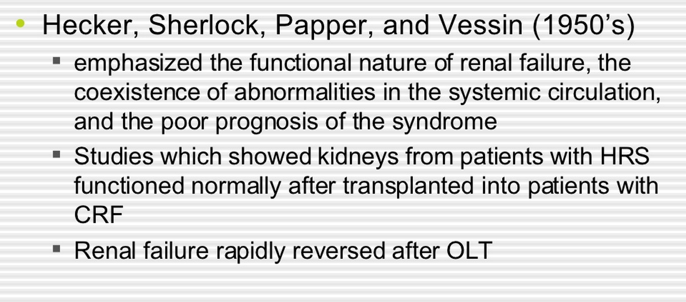

Slide 7
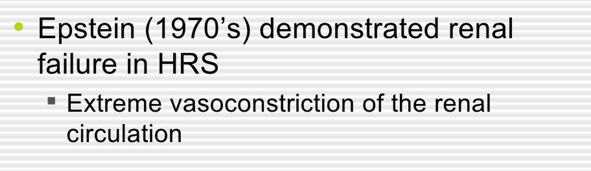

Slide 8
Hepatorenal Syndrome
The most distal form of prerenal azotemia
It is solely the result of intense renal underperfusion
The kidney is otherwise normal
If transplanted it behave like any other kidney

Slide 9
Major compromise of EABV
Renal perfusion falls below the capacity of renal autoregulation
Renal failure develops solely as a consequence of decreased perfusion
If liver function improves so does GFR

Slide 10
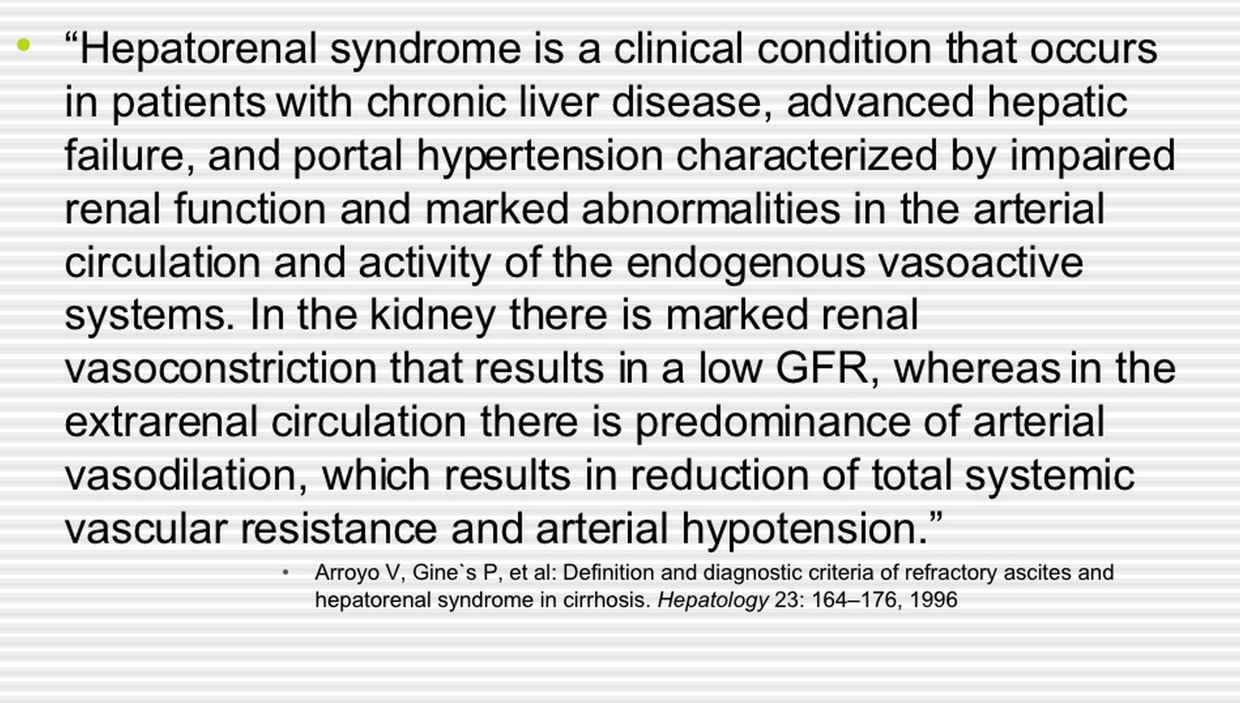

Slide 11
Munoz S. Medical Clinics of North America July 2008
HRS is a form of acute or subacute renal failure characterized by severe renal vasoconstriction, which develops in decompensated cirrhosis or ALF
Nearly half of patients die within 2 weeks of this diagnosis
The annual incidence of HRS ranges between 8% and 40% in cirrhosis depending on the MELD score
The frequency of HRS in severe acute alcoholic hepatitis and in fulminant liver failure is about 30% and 55%, respectively

Slide 12
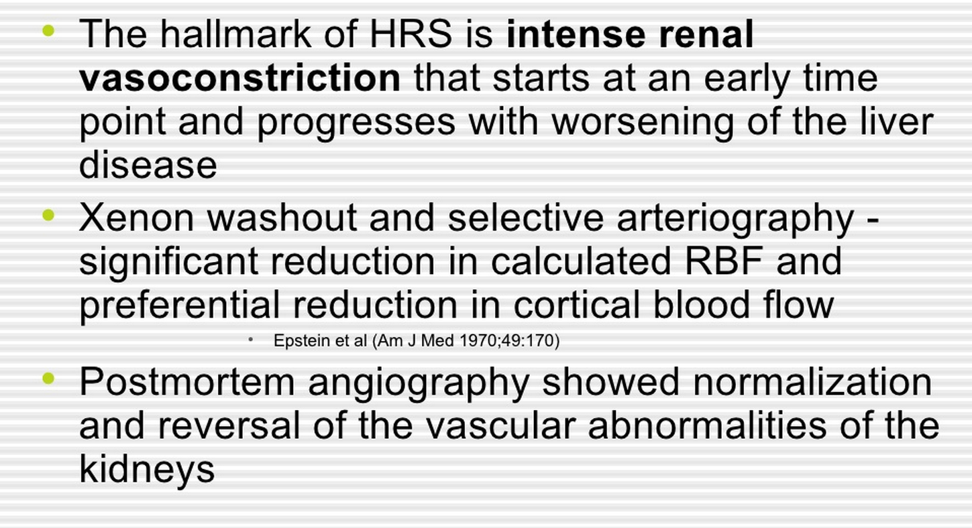

Slide 13
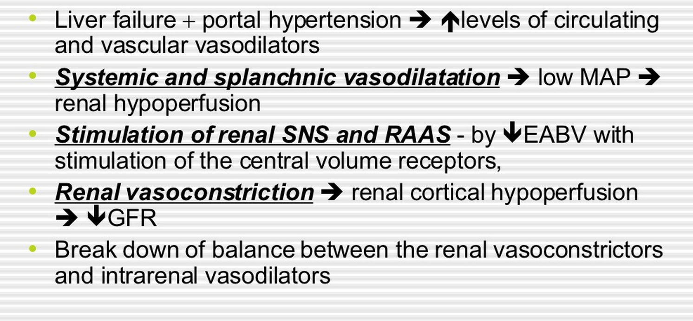

Slide 14
Progressive Liver Disease
Systemic vasodilatation
Renal vasoconstriction

Slide 15
Vasodilatation
Glucagon
Vasoactive intestinal peptide
Prostaglandins
Substance P
Platelet activating factor
NO
CO
Endogenous cannabinoids

Slide 16
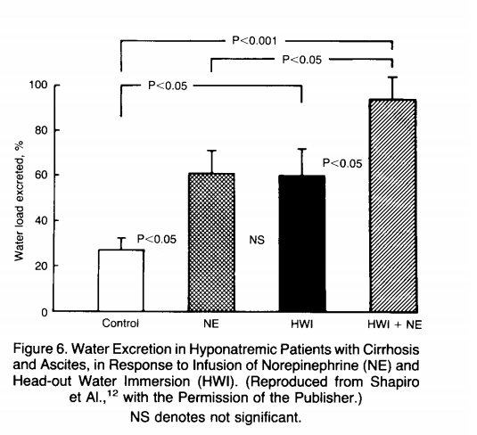

Slide 17
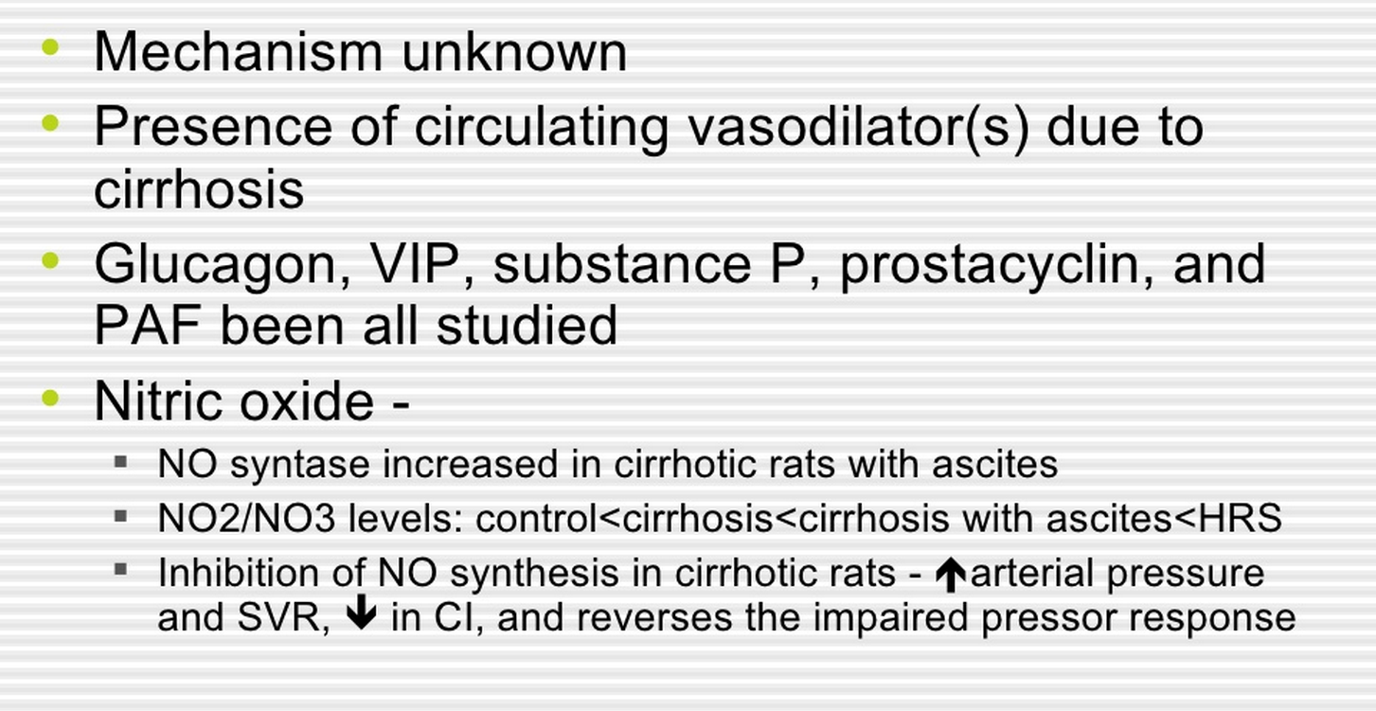
Notes:
vasoactive intestinal polypeptide, substance P (SP) is a neuropeptide

Slide 18
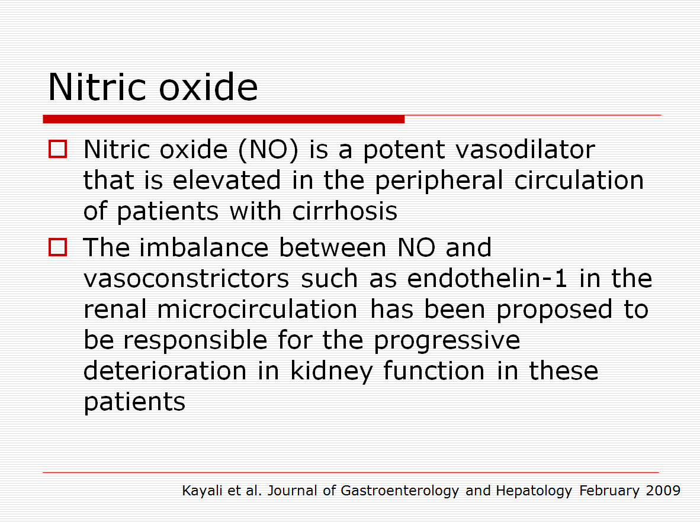

Slide 19
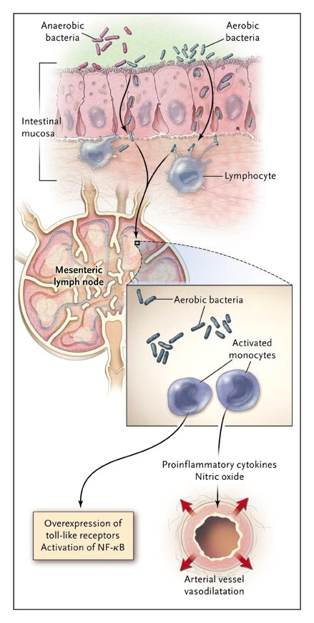
Potential Role of Bacterial Translocation and Cytokine Overproduction on Splanchnic Arterial Vasodilatation.
Ginès P, Schrier RW. N Engl J Med 2009;361:1279-1290.
Notes:
Figure 2. Potential Role of Bacterial Translocation and Cytokine Overproduction on Splanchnic Arterial Vasodilatation. A number of factors, such as intestinal bacterial overgrowth, impaired intestinal motility, alterations in gut permeability, and disturbances in local immune systems, can lead to passage of aerobic bacteria from the intestinal lumen to the mesenteric lymph nodes. This translocation results in activation of monocytes with overexpression of toll-like receptors, activation of nuclear factor kappa B (NF-κB), and increased local production of proinflammatory cytokines and vasodilator factors, such as nitric oxide. These cytokines and vasodilator factors cause further vasodilatation of splanchnic arterial vessels. In general, anaerobic bacteria do not translocate.

Slide 20
Renal Vasoconstriction
Vasopressin
Renin
Norepinephrine

Slide 21
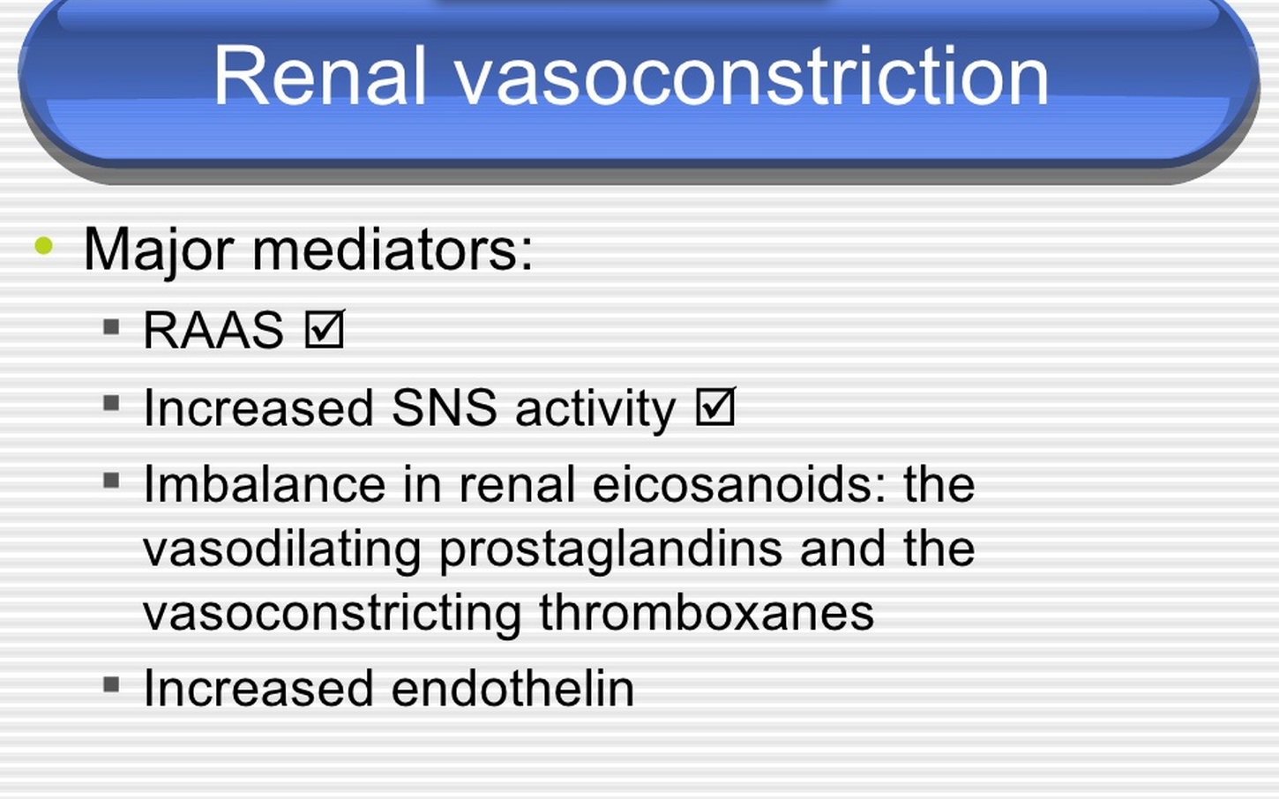

Slide 22
Course of the Hepatorenal Syndrome
A-V micro fistulae
Decreased EABV
Modest salt retention

Slide 23
Increased cardiac output
Splanchnic vasodilatation
Portal hypertension
Ascites

Slide 24
Susceptibility to renal injury greatly increased
ATN
Interstitial nephritis
Bacterial peritonitis

Slide 25
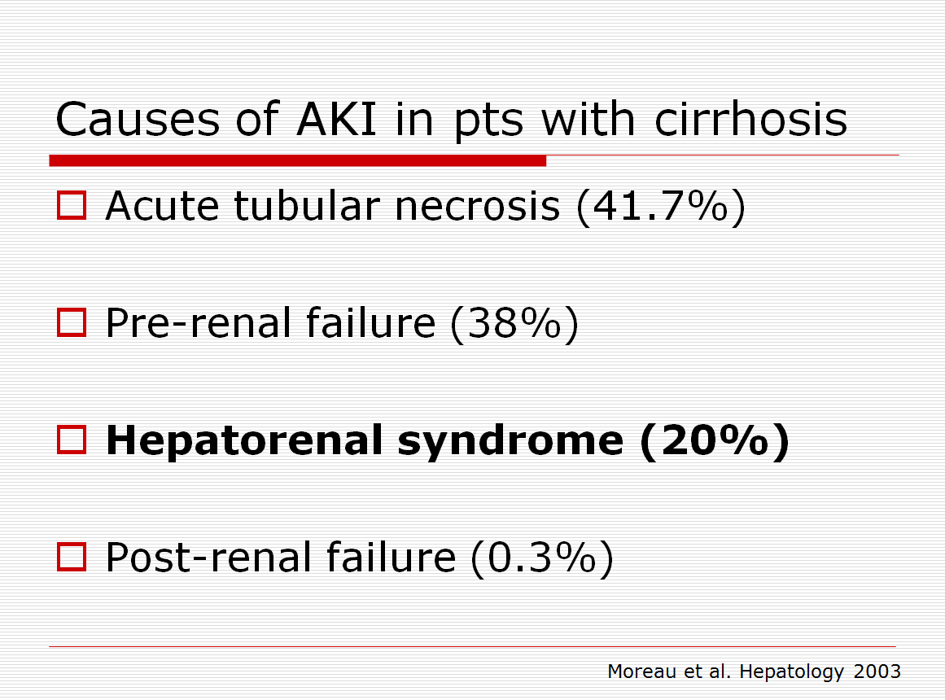

Slide 26
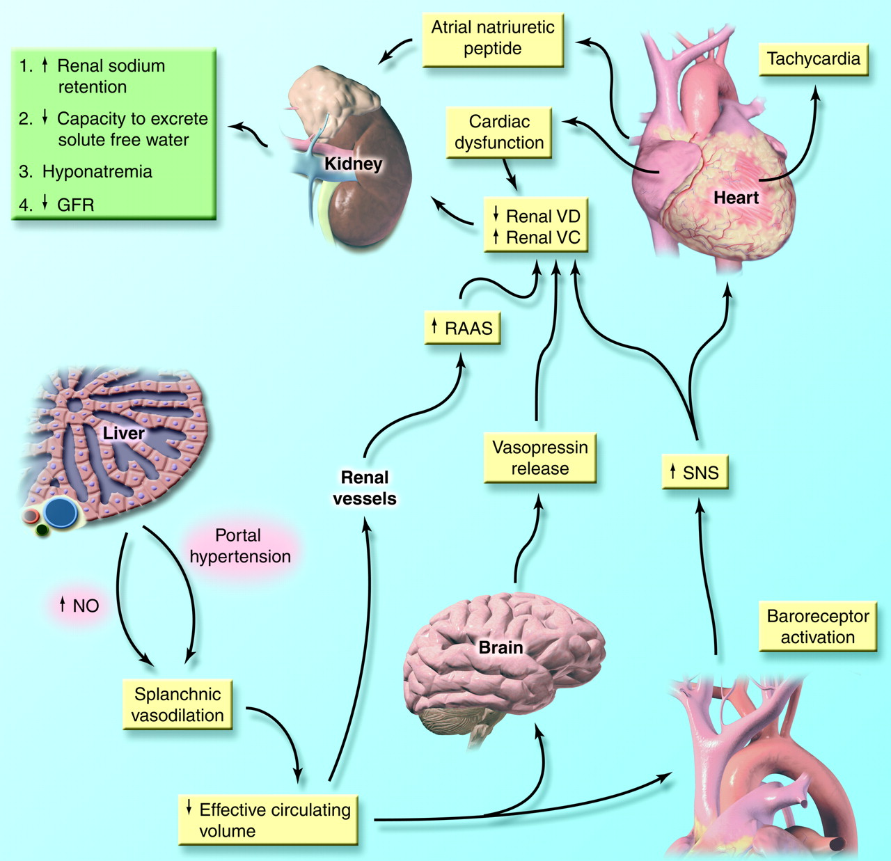

Slide 27
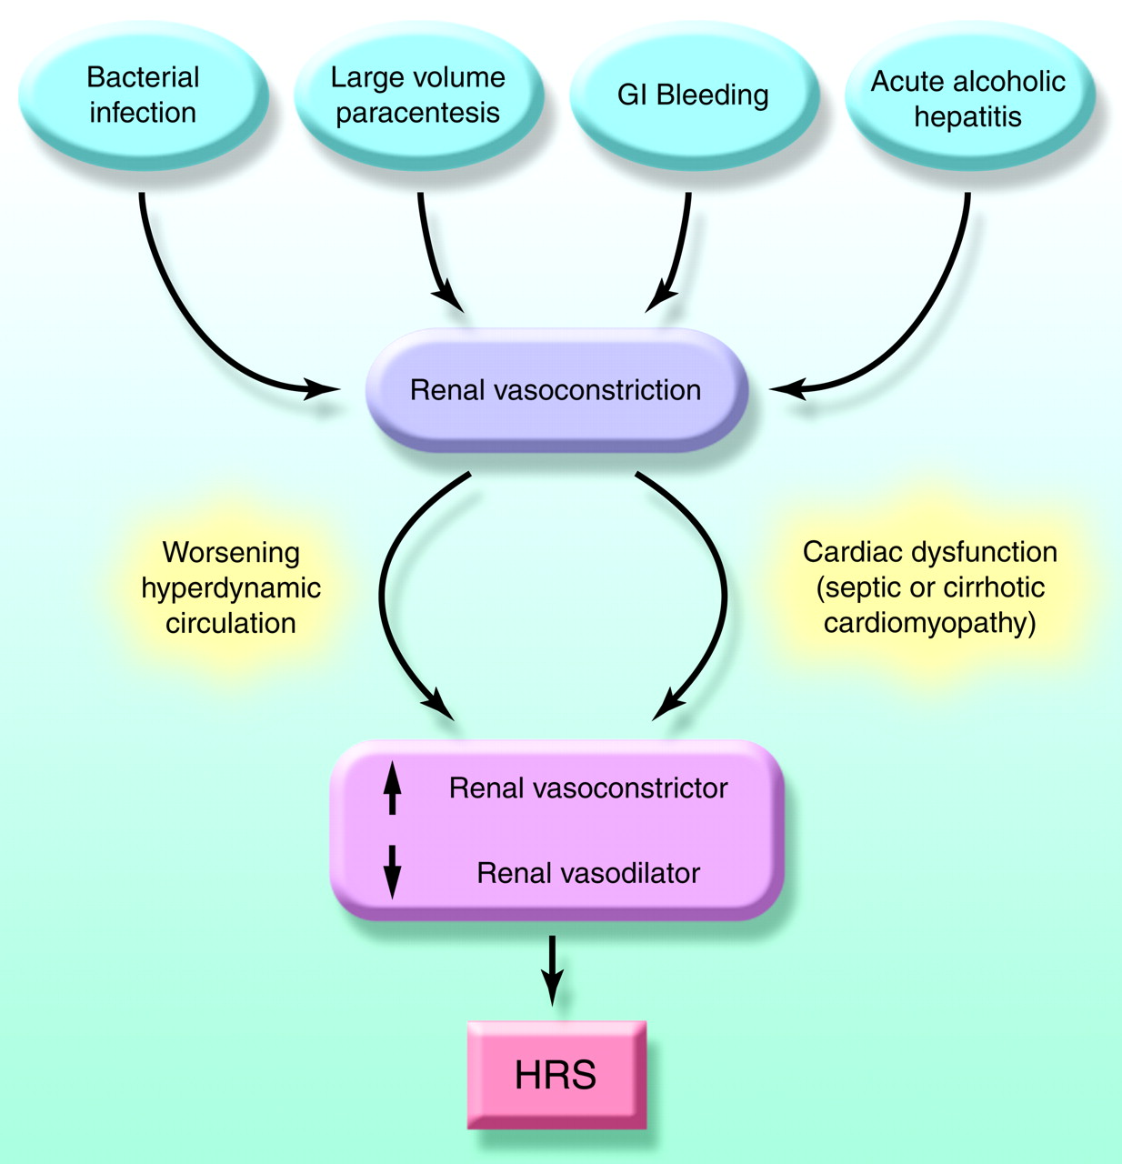

Slide 28
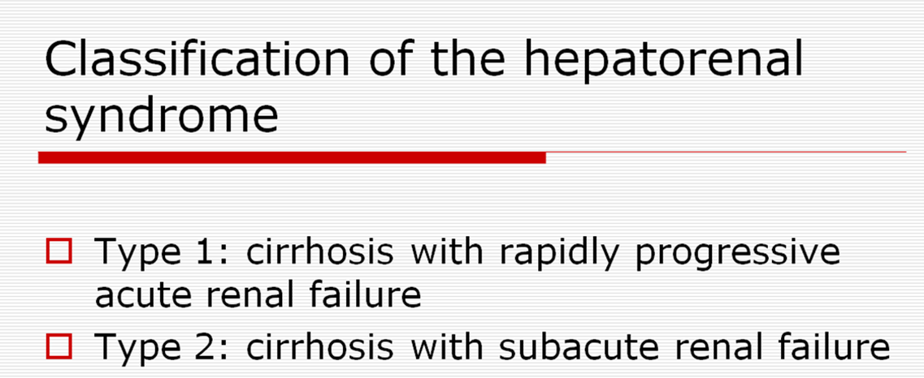

Slide 29
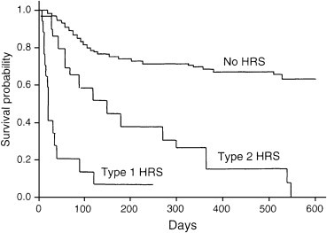

Slide 30
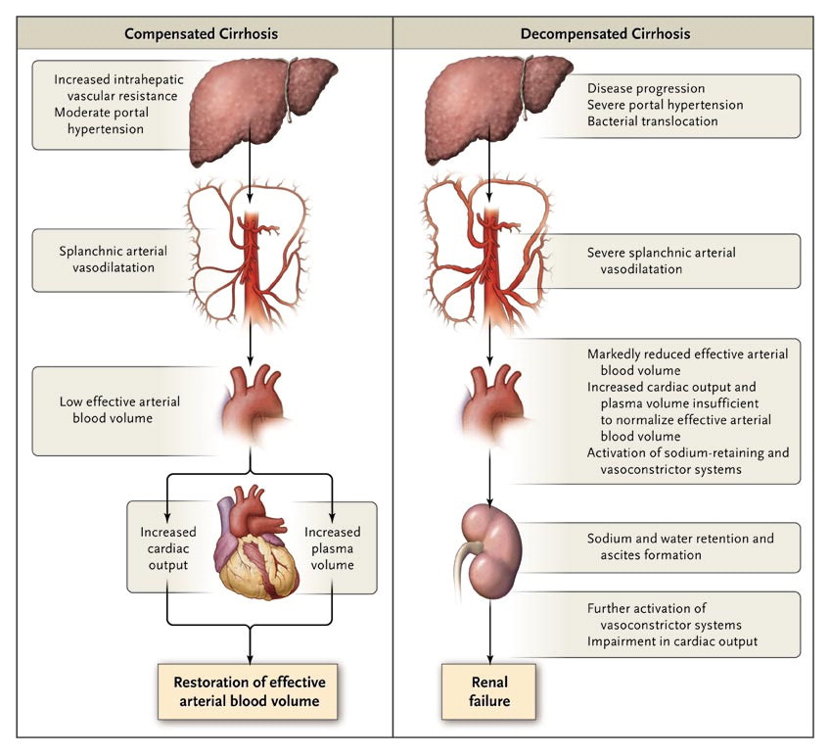

Slide 31
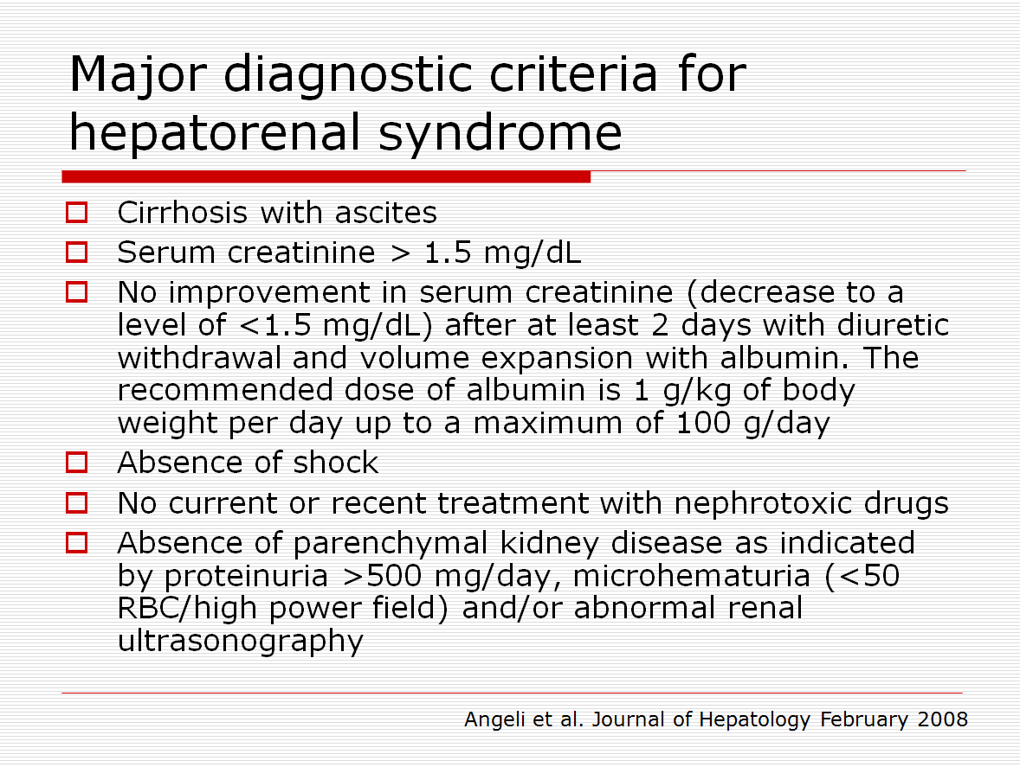

Slide 32
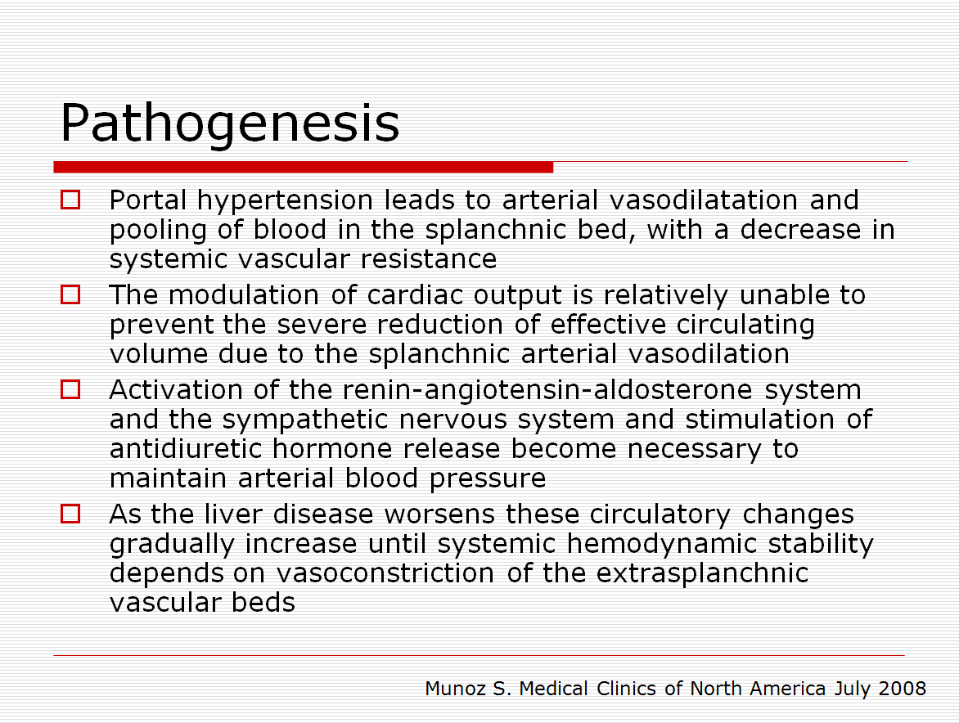

Slide 33
Consequences
Salt retention
Ascites and edema
Water retention
Hyponatremia –the lower the worse the outcome
Decreased GFR
Renal Failure

Slide 34
Assessing kidney function in pts with cirrhosis
Cr assays are subject to interference by chromogens, bilirubin being the major one
There is decreased hepatic production of creatinine
The edematous state that complicates end-stage liver disease leads to large distribution of Cr in the body and lower serum Cr concentration
Complications such as variceal bleeding, spontaneous bacterial peritonitis or sepsis lead to increased Cr tubular excretion

Slide 35
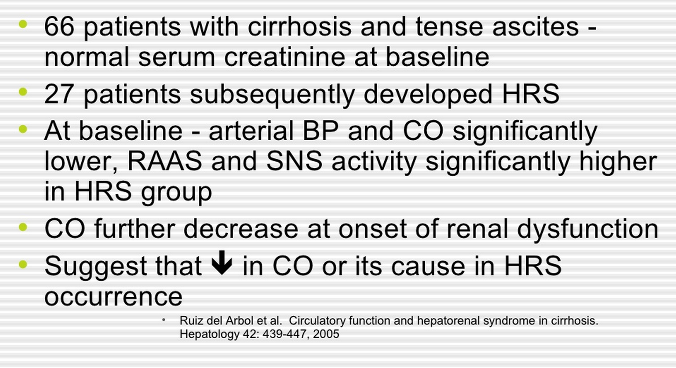

Slide 36
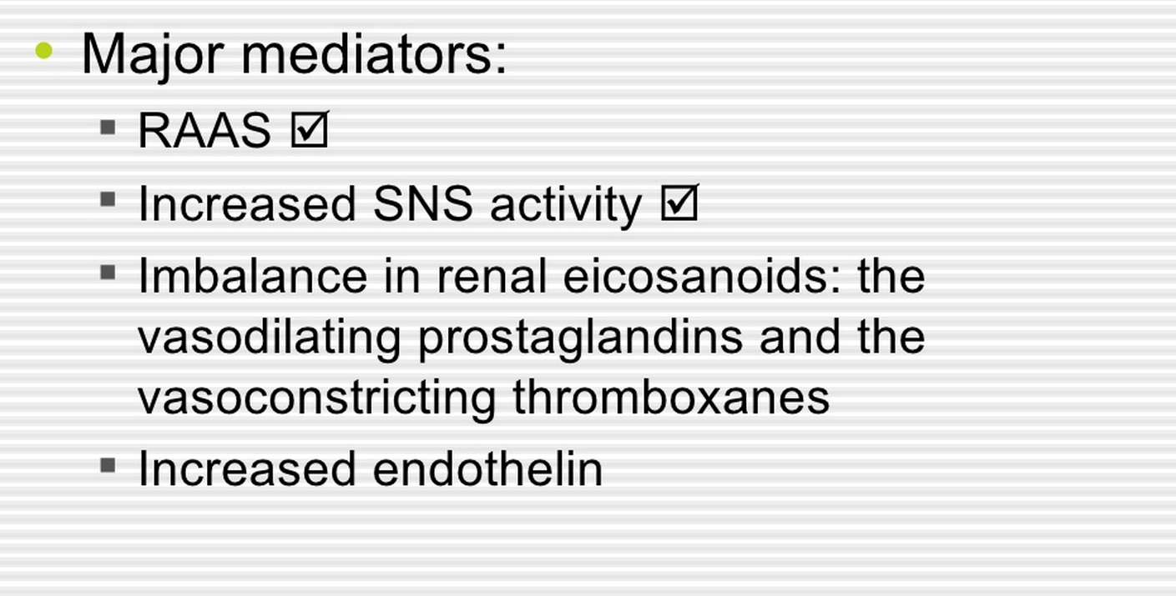

Slide 37
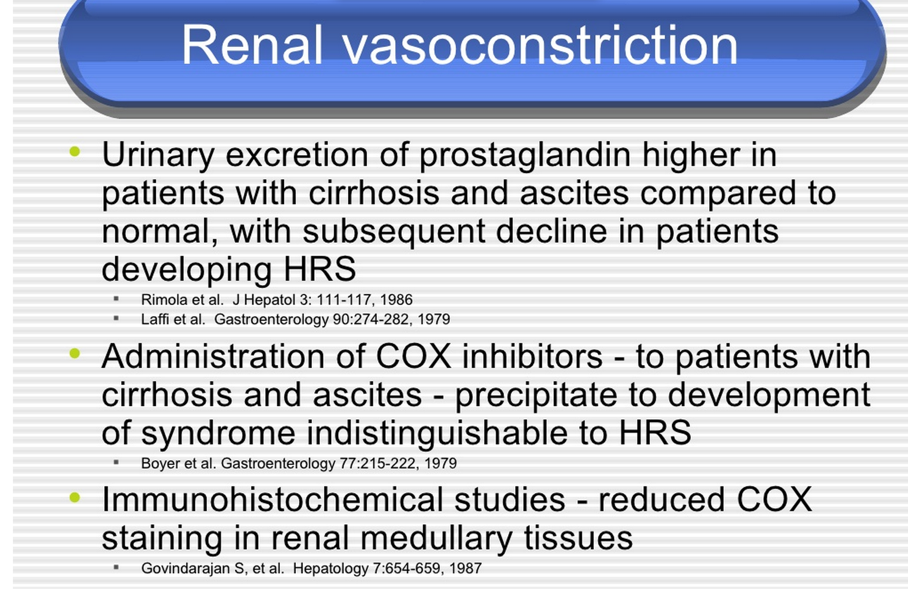

Slide 38
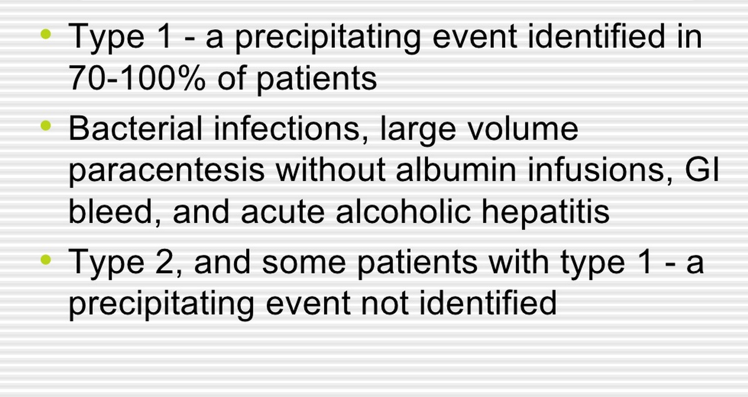

Slide 39
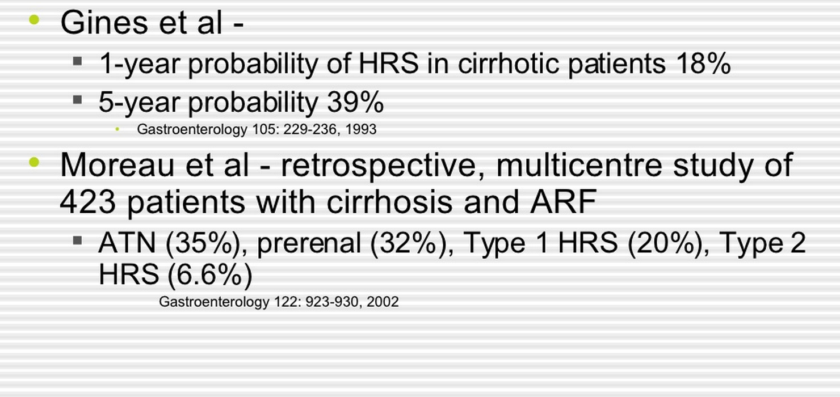

Slide 40
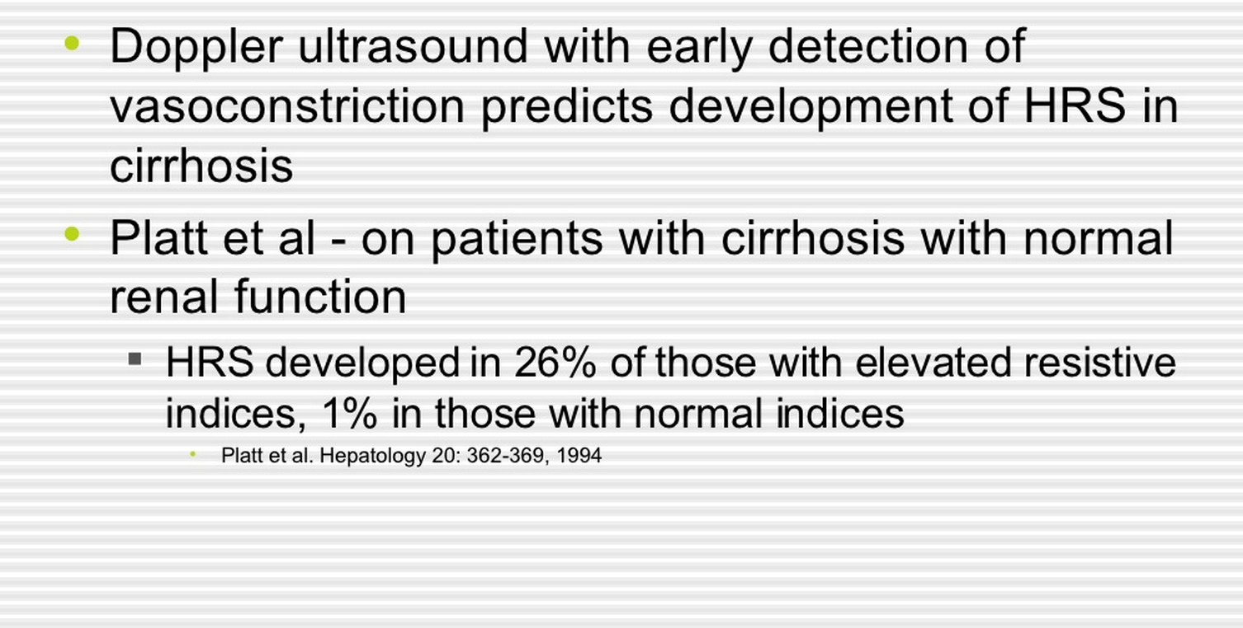

Slide 41
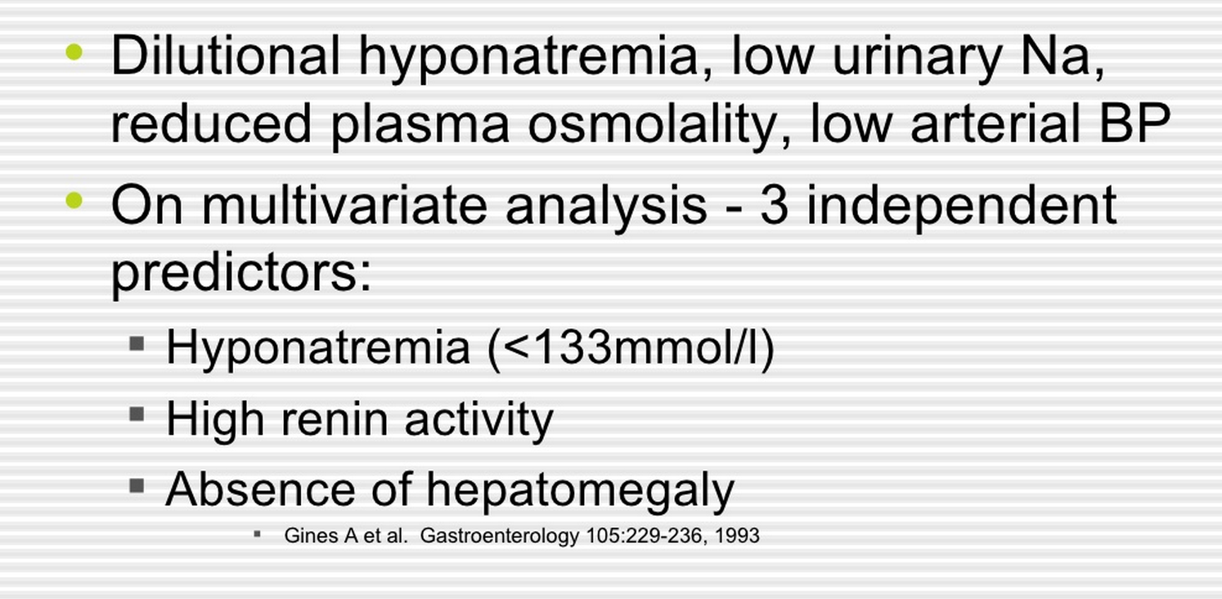

Slide 42
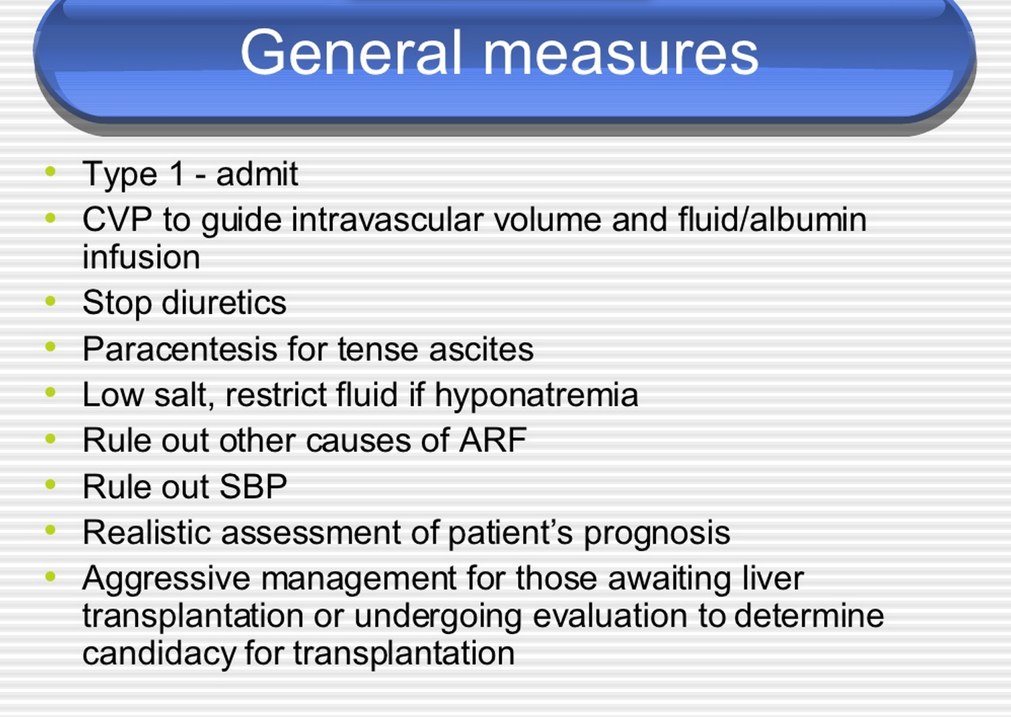

Slide 43
Rx
Fix liver disease, all else is peripheral
Midodrine and octreotide
Vasopressin analogues and albumin
Diuretics – very cautiously
Hemodialysis – unproven benefit
Notes:
M alpha 1 adrenergic agonist (vc). O somatostatin analog (vd)

Slide 44
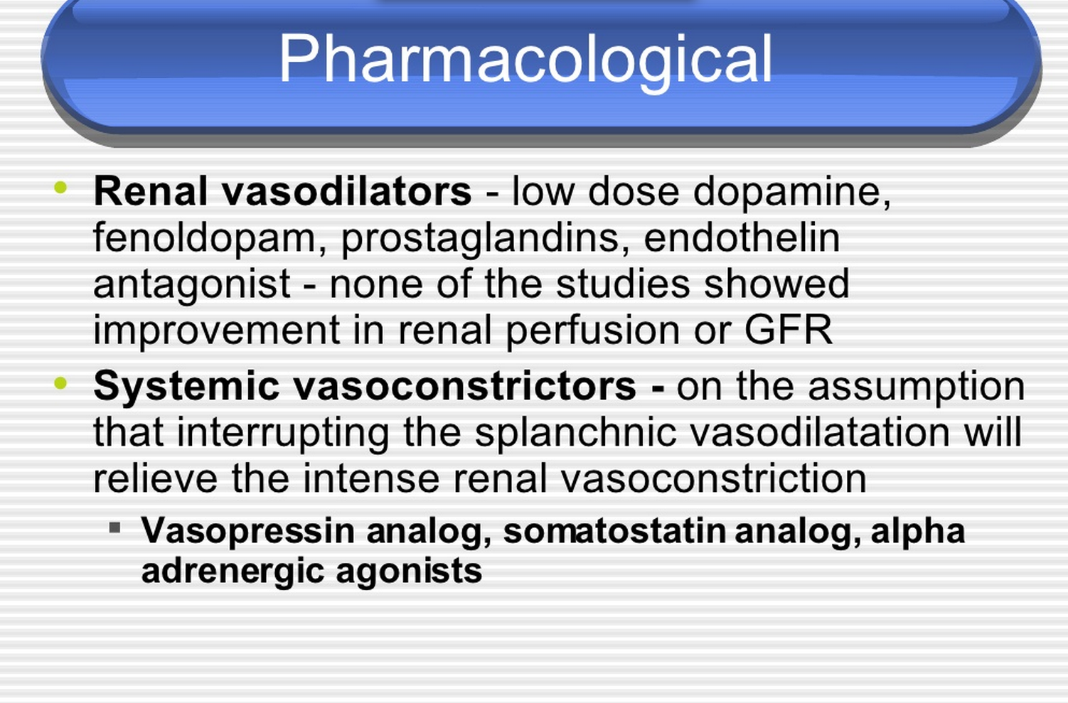

Slide 45
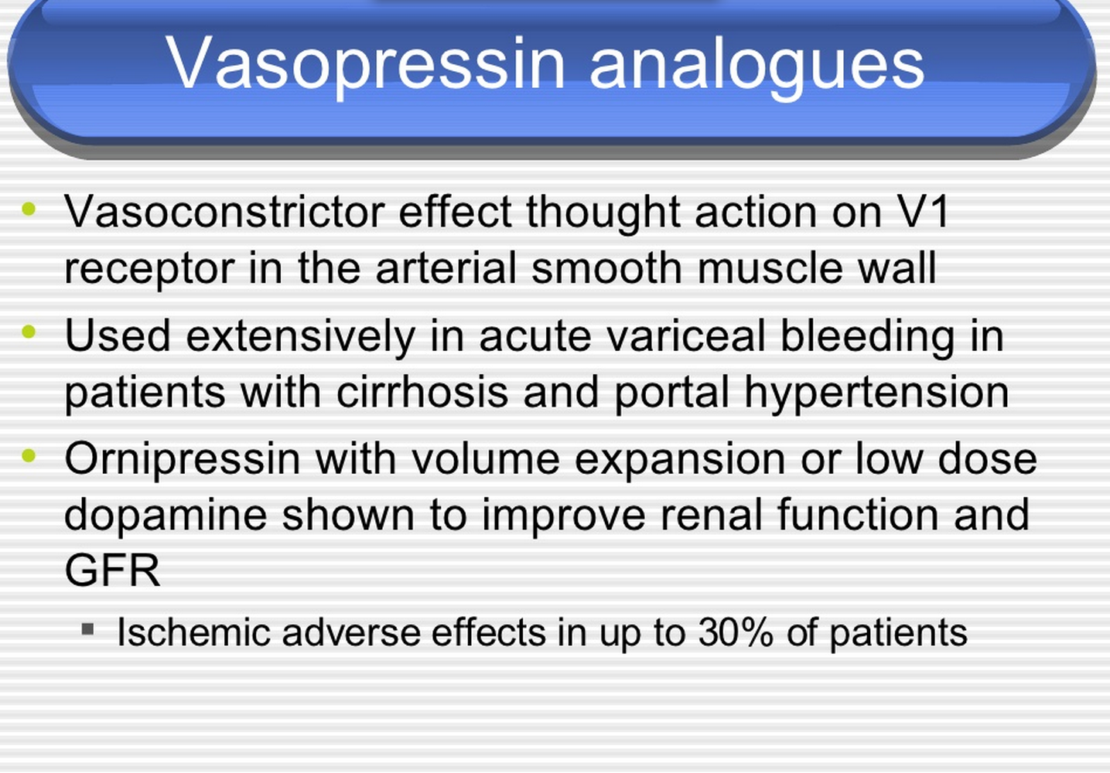

Slide 46
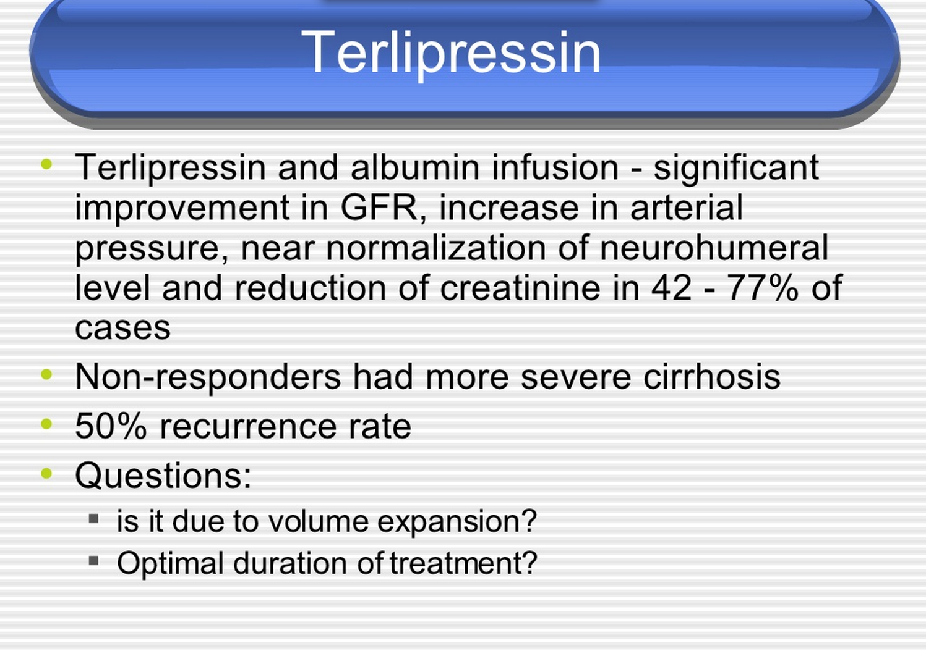

Slide 47
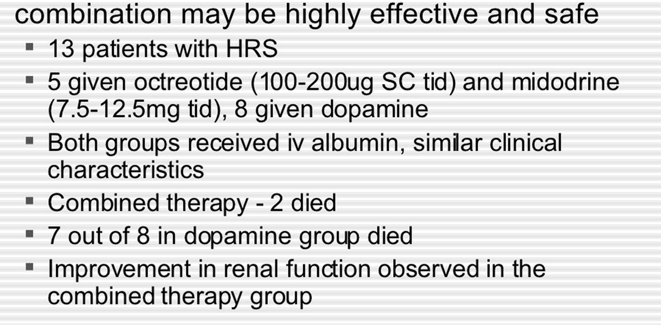
Octreotide (somatostatin) and midodrine with albumin infusion

Slide 48
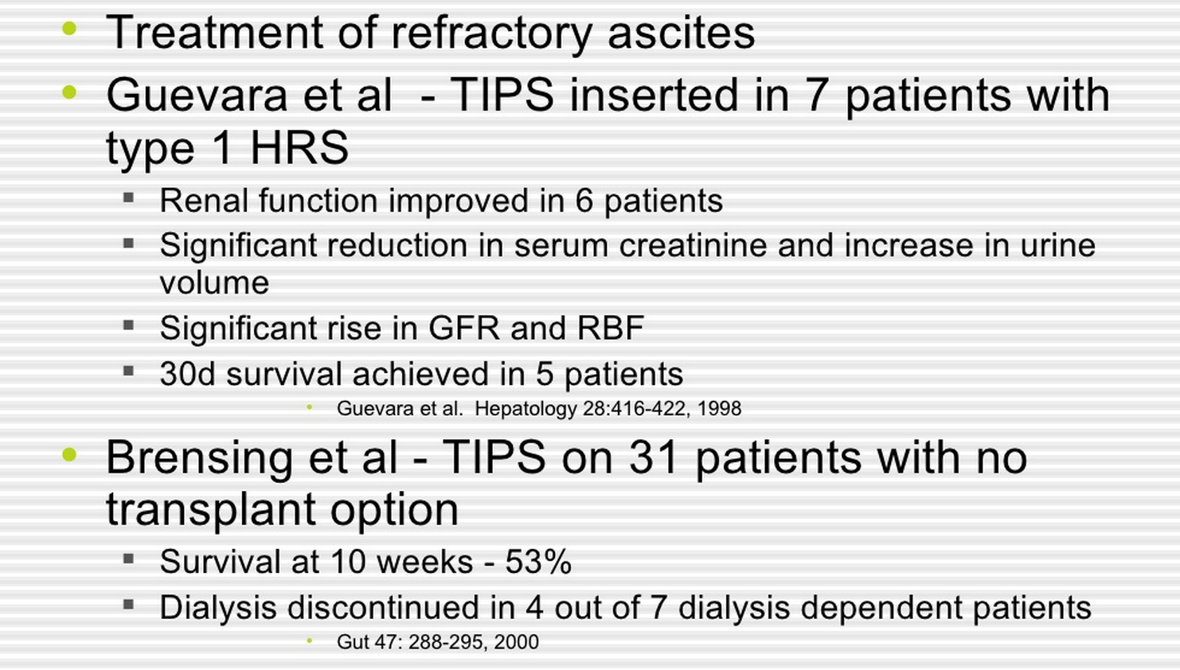
Notes:
Transjugular Intrahepatic Portosystemic Shunt

Slide 49
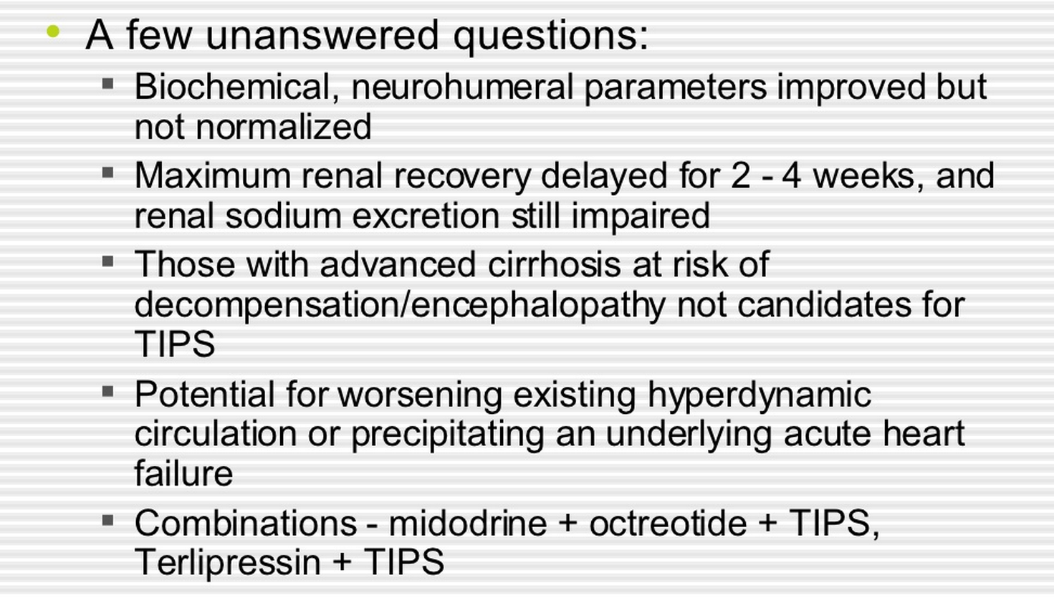

Slide 50
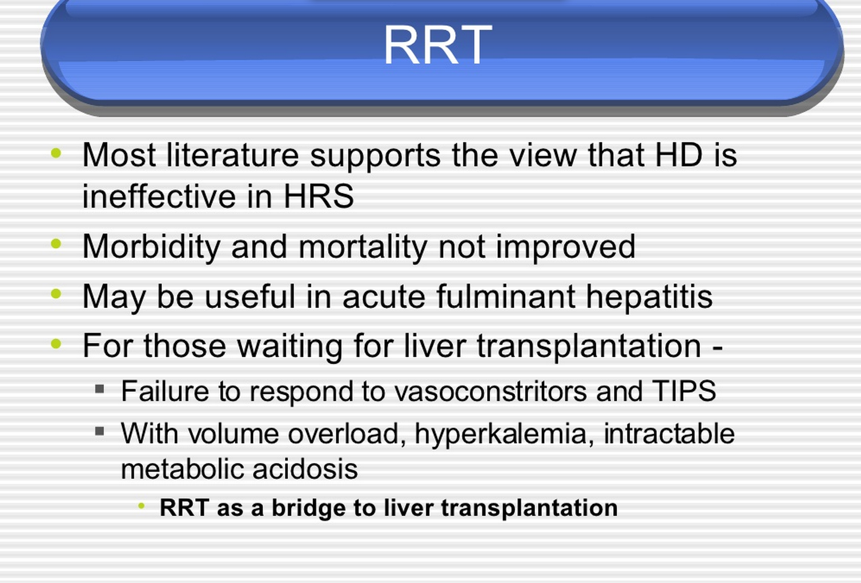

Slide 51
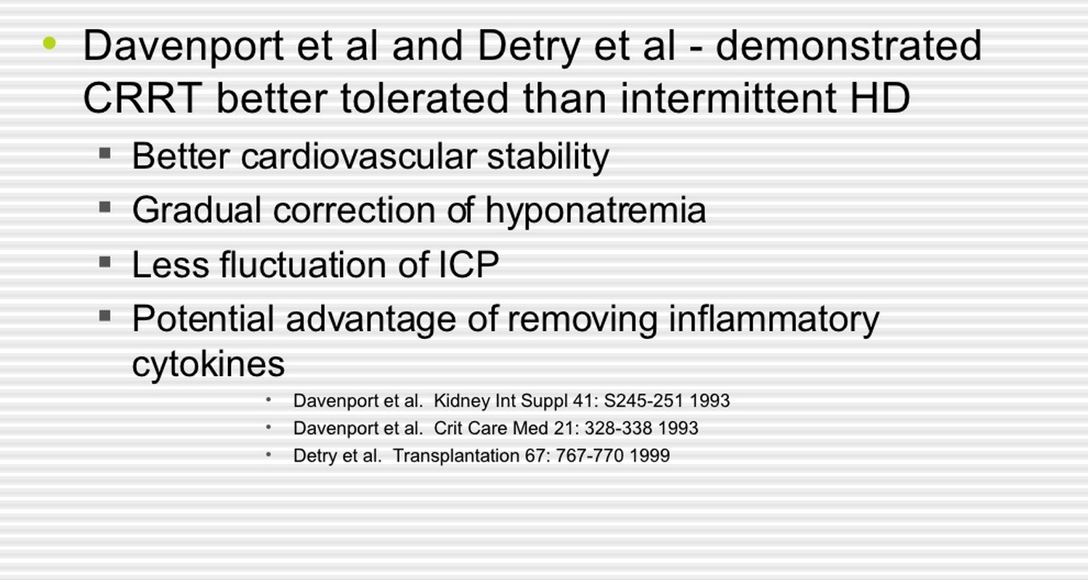

Slide 52
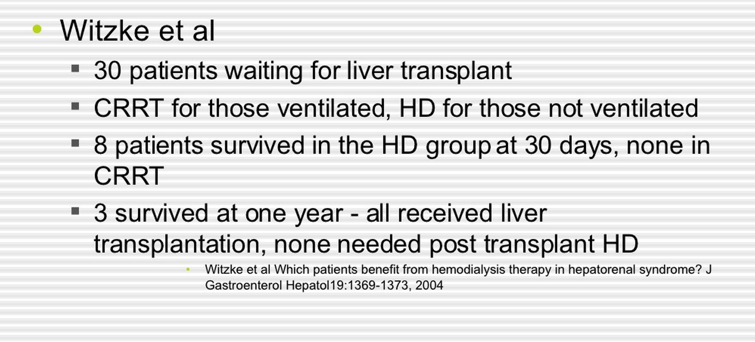

Slide 53
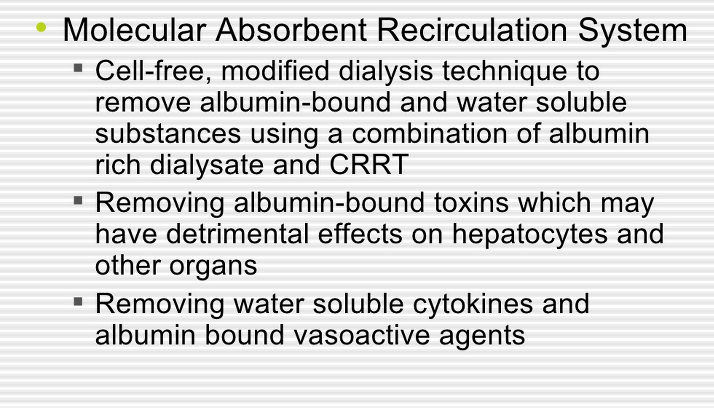

Slide 54
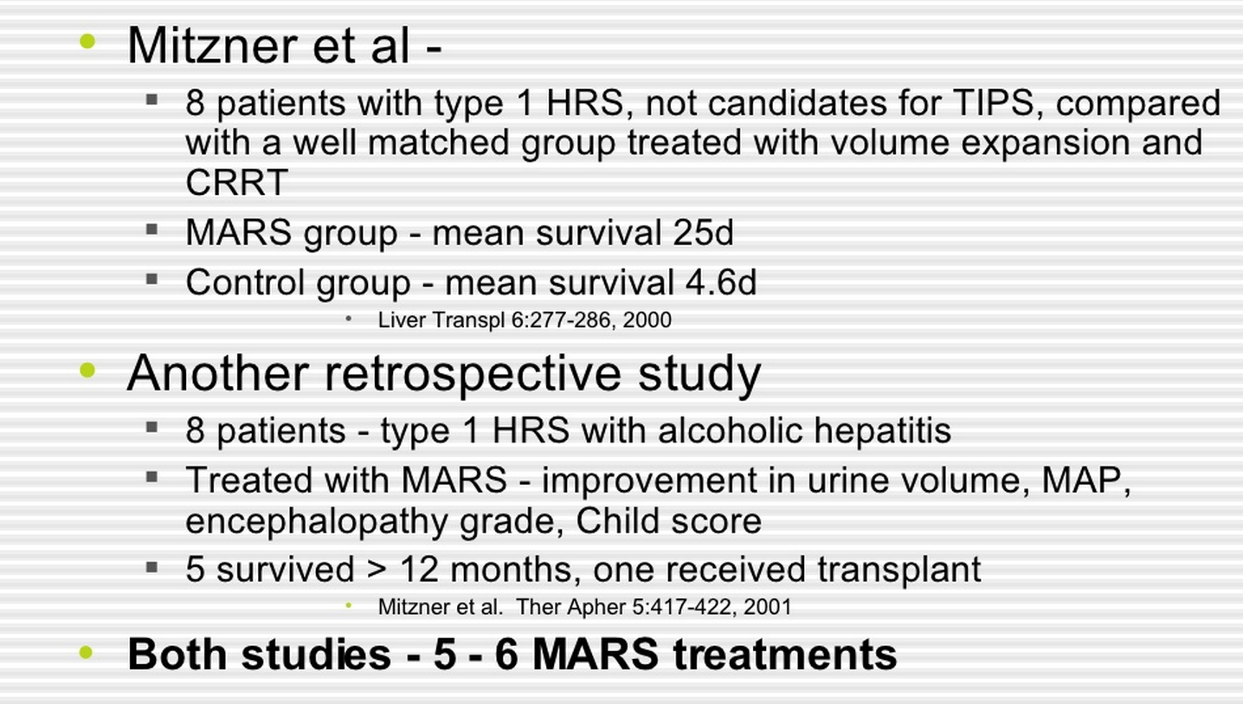

Slide 55
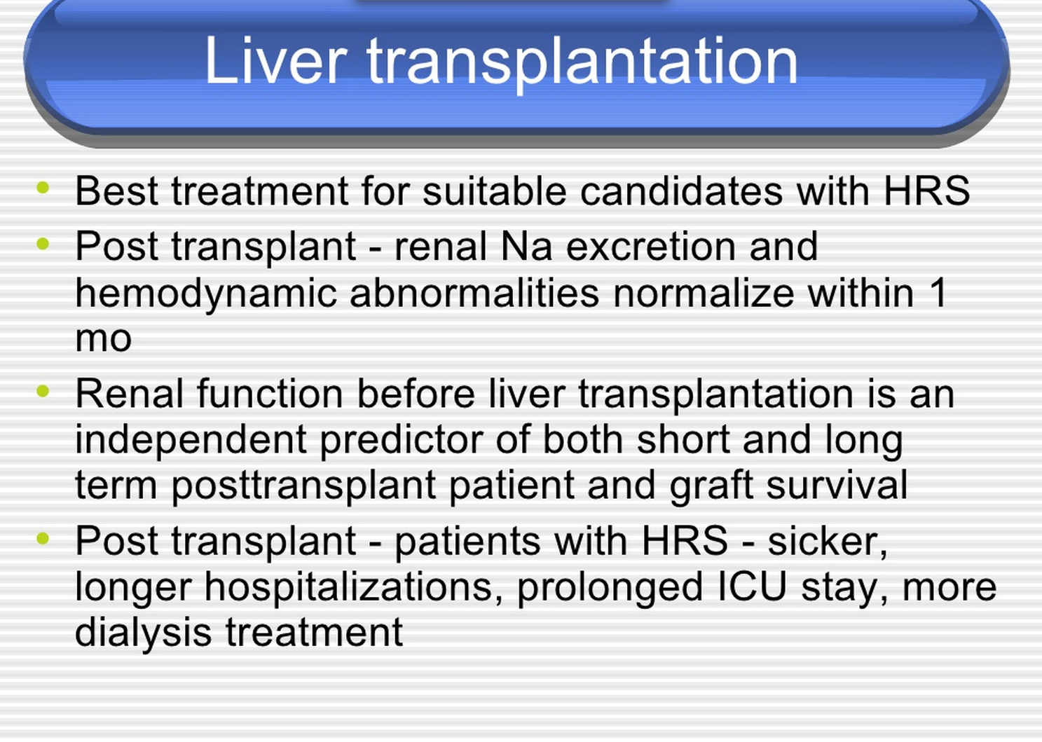

Slide 56
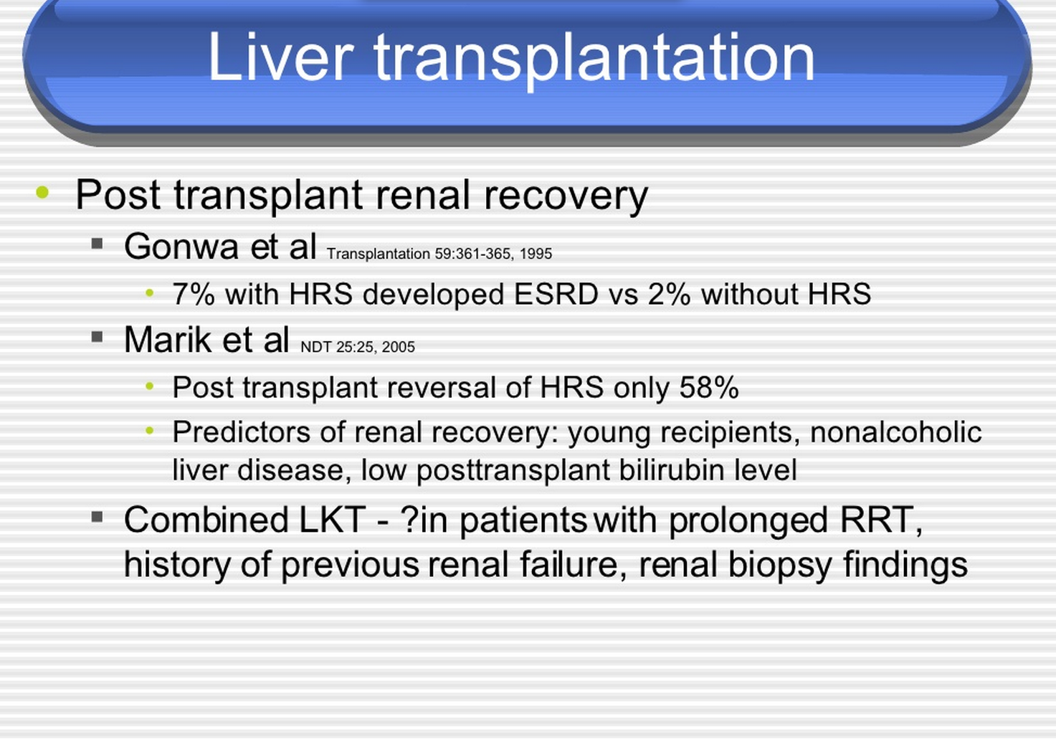

Slide 57
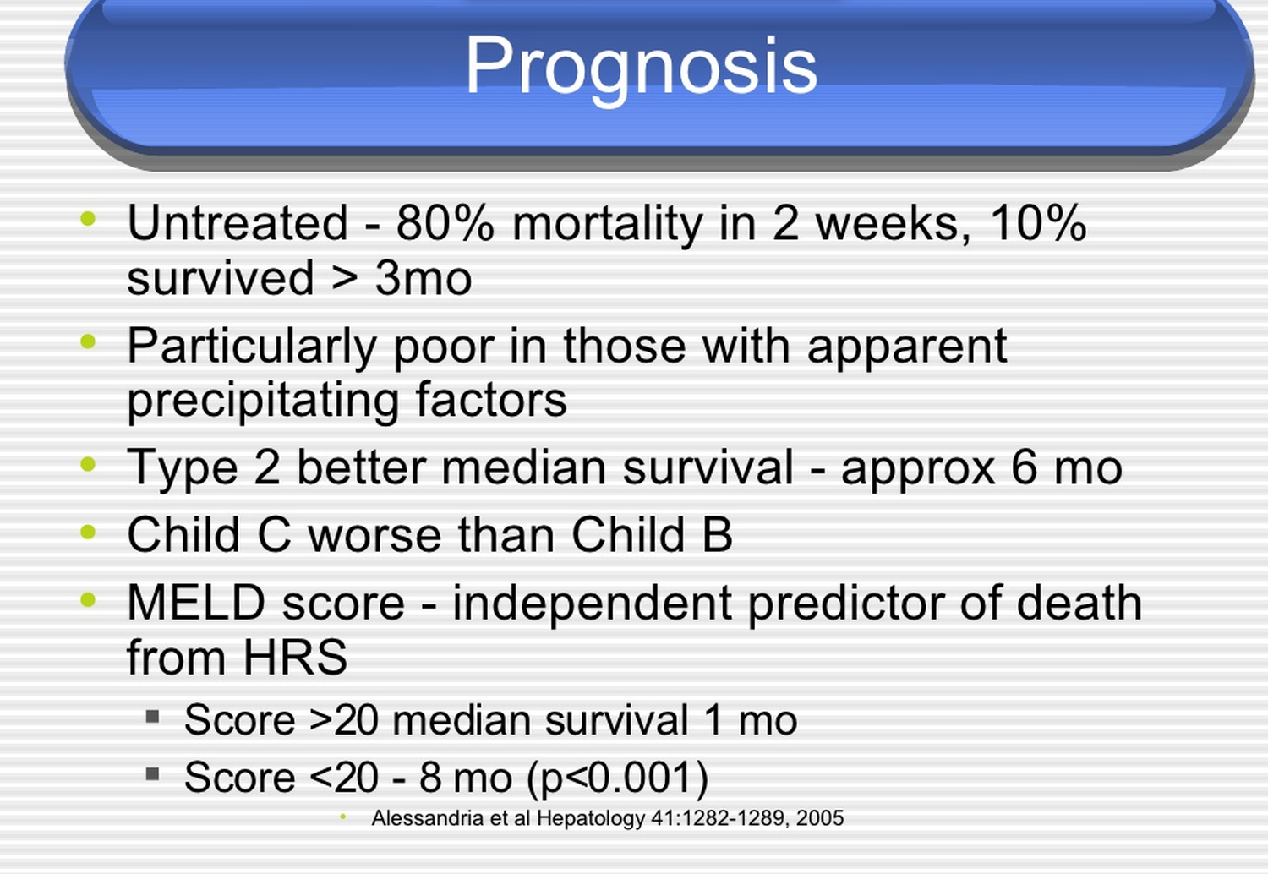
Notes:
Model for End-Stage Liver Disease, Child-Pugh score

Slide 58
Summary
The HRS is a secondary event that complicates the course of severe liver disease. Absent an improvement in hepatic function, treatment is essentially futile.

Slide 63
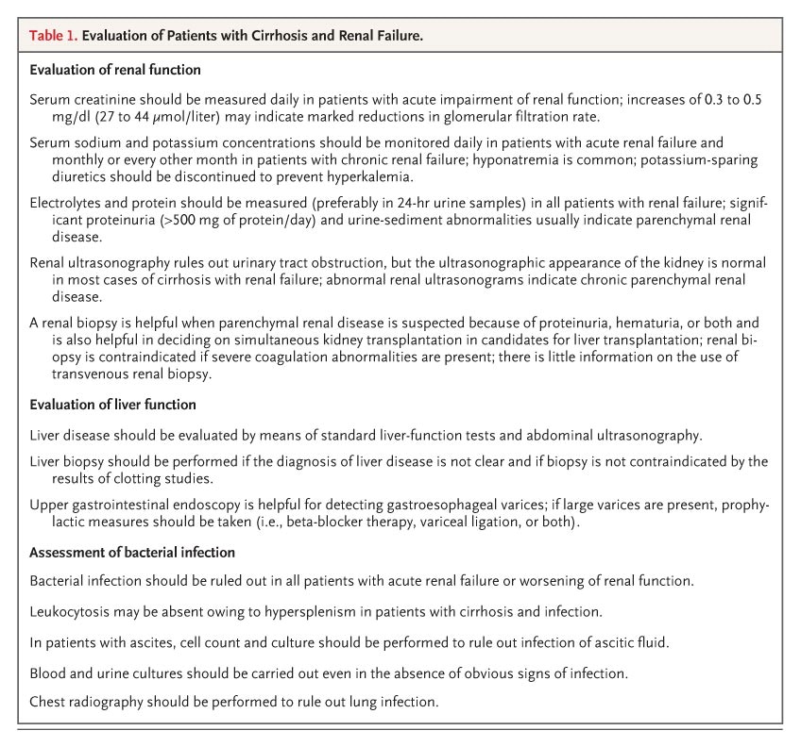
Evaluation of Patients with Cirrhosis and Renal Failure.

Slide 64
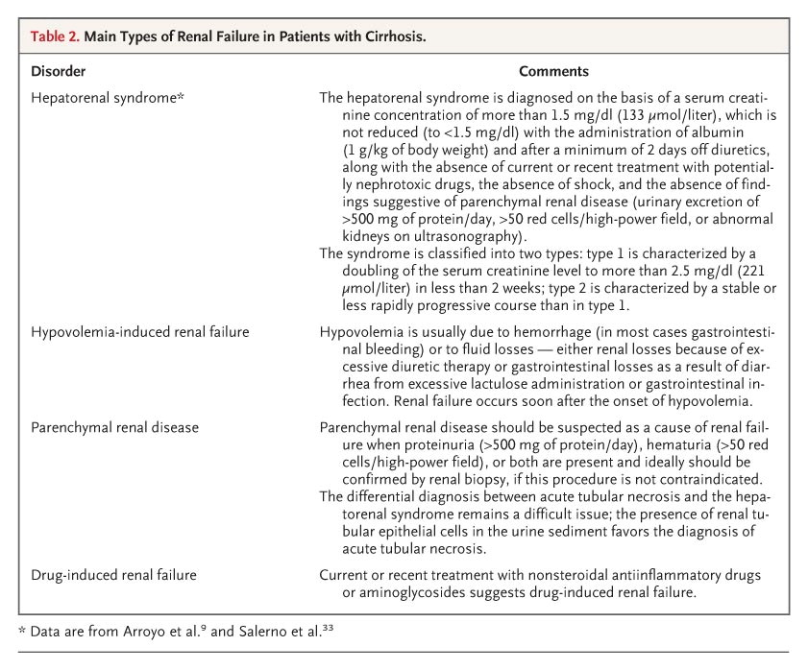
Main Types of Renal Failure in Patients with Cirrhosis.

Slide 65
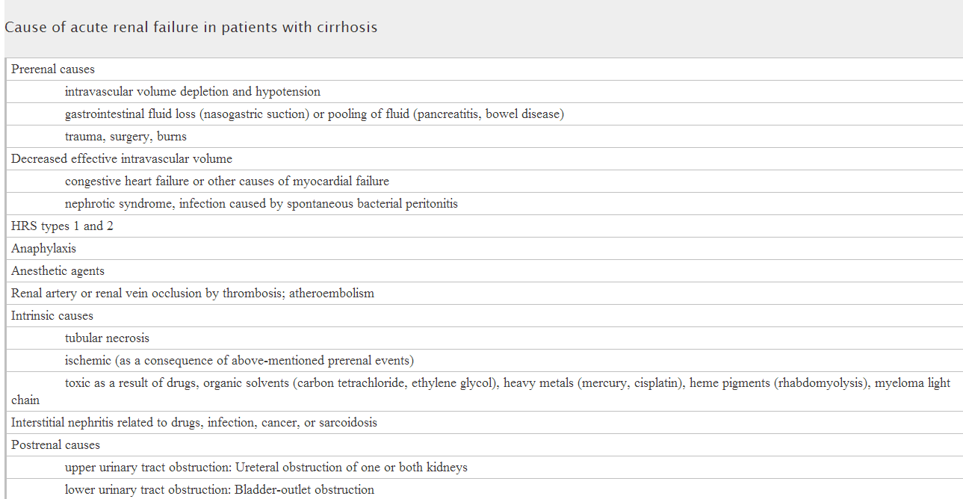

Slide 66
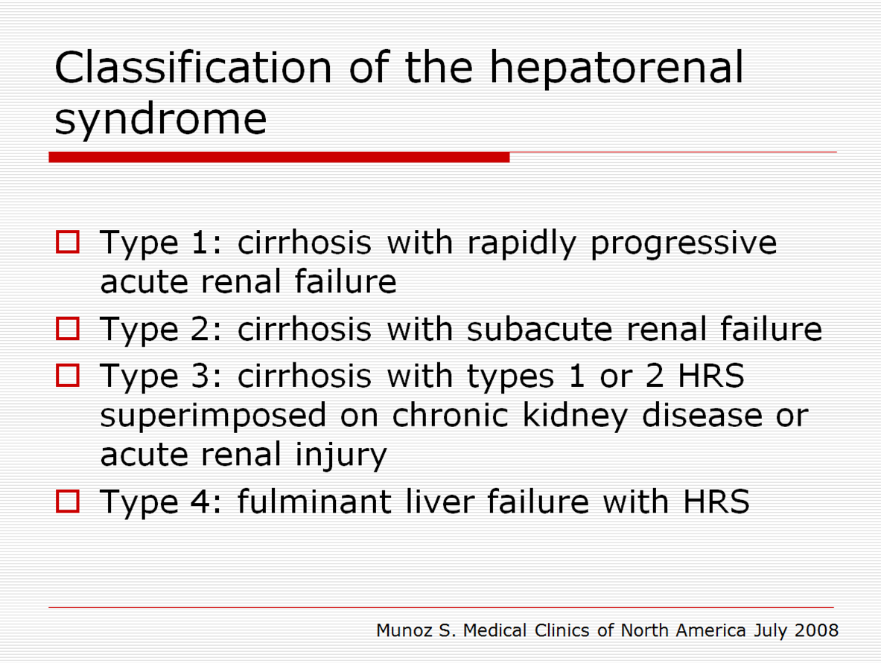

Slide 67
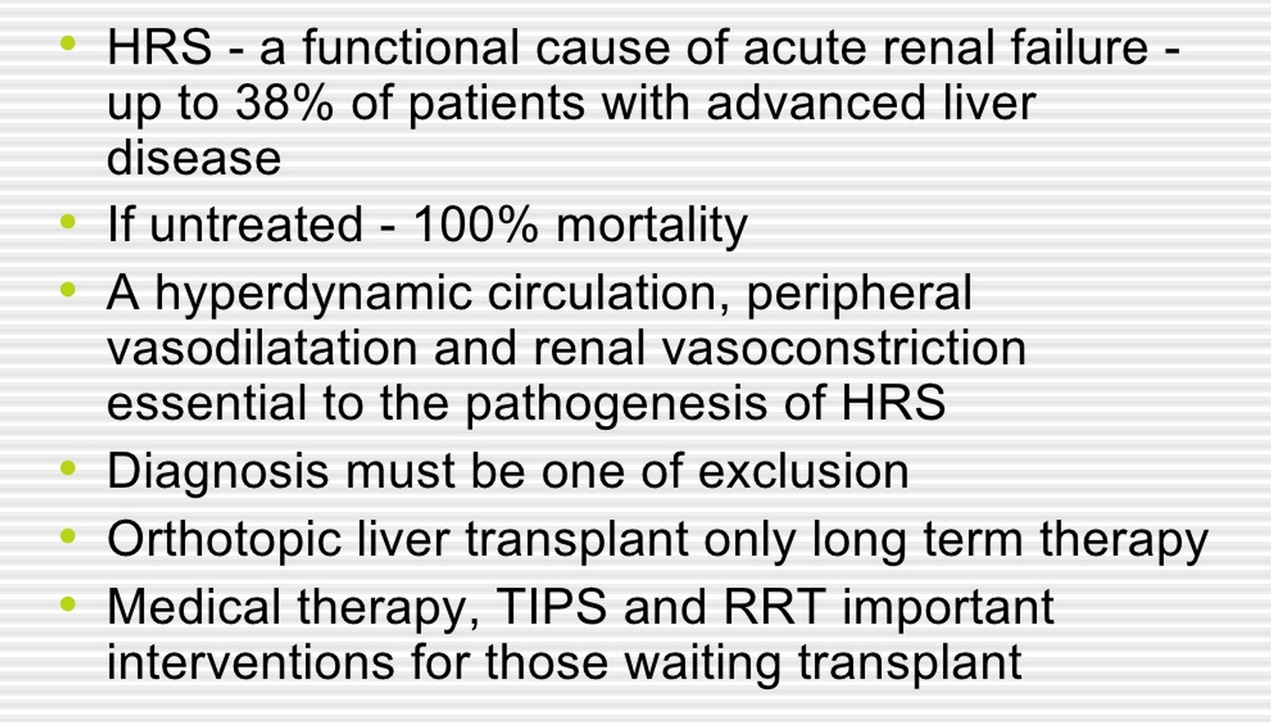

Slide 68
